Slide 1
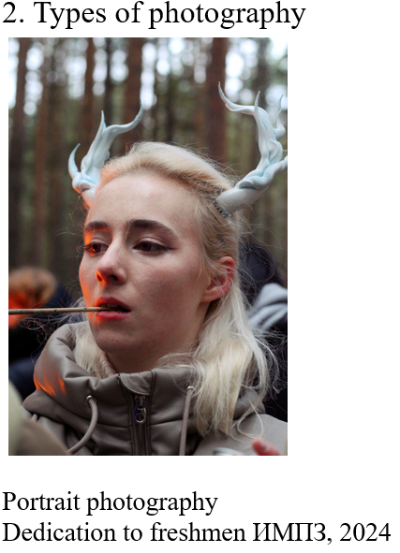
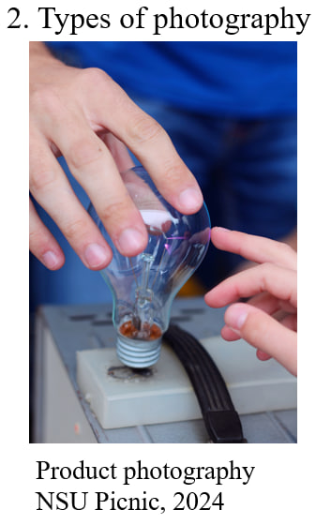
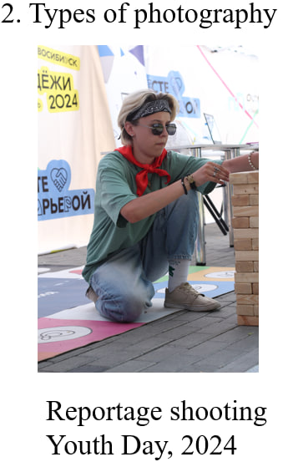
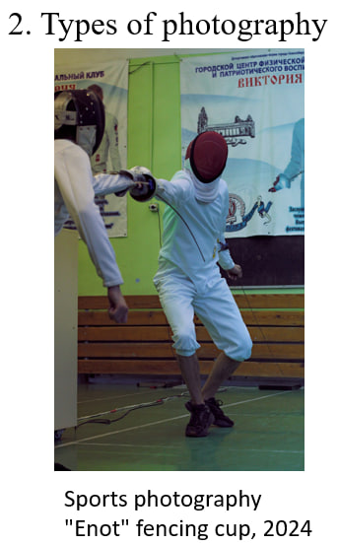
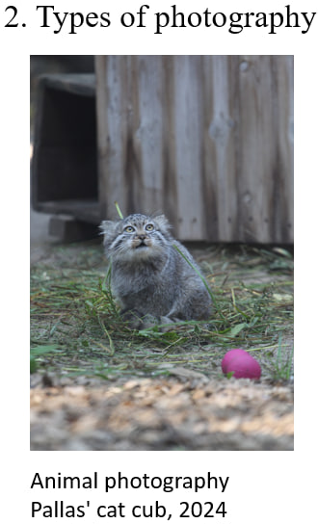

Skill: take pictures
Goal: Where to start in photography?
3.Photo Editing
1. Understand the Basics
First, you need to choose software (for example, Photoshop, Lightroom or their analogues). Next, we crop and straighten the photo => adjust the brightness and contrast => adjust the color correction and white balance => adjust the sharpness and remove excess in the photo
To learn to take good photos, you need about a year of practice. But you can quickly understand basic concepts like framing, lighting, and composition. With time, taking good photos gets easier
Practice
Skill:take pictures

